Slide 1
Describe the central processing unit including its role
Describe internal memory, i.e. ROM and RAM and the differences between them
Define input and output devices and describe the difference between them
Define secondary/backing storage

Slide 2
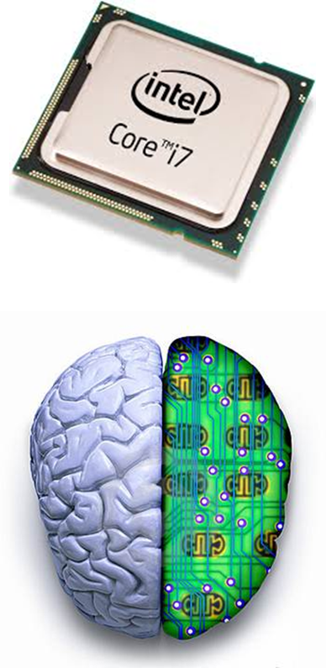
CPU: Fill in the blanks
The CPU is the ________ of the computer.
It is where all the searching, sorting, _________ and _________ making takes place.
The speed of the CPU is measured in _________ (GHz).
A 1 GHz CPU can carry out 1 ________ _________ per second!
Intel and AMD are the most popular CPU brands.
Billion
Decision
Gigahertz
brain
Calculating
Instructions

Slide 3
 |  | 1
 |  |  |  |  |  |  |  |  |  |  |  |  |  |  |  | 4
 |  |  |  |  |  | 2 |  |  |  |  |  |  |  |  |  |  |  |  |  |  |  | 5
 | 1
 |  |  |  |  |  |  |  |  |  |  |  |  | 2
3
 |  |  |  |  |  |  |  |  |  |  |  |  |  |  |  |  |  | 4
 |  |  |  |  |  |  |  |  |  |  |  |  |  | 5
 |  |  |  |  | 6 |  |  |  |  |  | 3
 |  |  |  |  |  |  |  |  |  |  | 7
 |  |  | 7
 |  |  |  |  |  | 6
Down
Portable storage
Device passes data into PC
Takes place in CPU
Devices connected to PC
Instructions found in ROM
Fastest Memory
Permanent Memory
Across
Used to store extra copies of data.
Holds temporary data also know as RAM
Devices which passes data out of PC.
Can be changed
Random Access Memory
Carries out calculations
An example is hard drive.

Slide 4
Main Memory – Place into correct sequence
1
If the data is not in the cache then the CPU will check the RAM and transfer data to the CPU.
2
The CPU will again check the Cache for the next piece of data. This time the CPU will be able to get the data from the Cache Memory.
3
Temporary data from Applications in use are held in the Main Memory.
4
The CPU will first check the Cache for the required piece of the data so that it can be processed.
5
Applications are installed in the Secondary Storage (Hard drive).
6
The Cache will then transfer the next piece of data from the RAM into Cache.

Slide 5
Place correct definitions in the appropriate category.
RAM
Non-volatile memory which means that memory is not lost when computer is turned off.
Volatile which means that when the computer is turned off all data is lost
Memory that can not be changed
R0M
Is used to store data for a long time (data can be read from and written to).
Non-volatile memory which means that memory is not lost when computer is turned off.
Random Access Memory
Backing Storage
Holds the ‘boot up’ instructions to start the computer
Users tend to make copies of original files
Read Only Memory
Stores the instructions temporarily whilst data is process by the CPU

